Slide 1



CSSE 579
Software Project Management:
Program, & Portfolio Management – “Old School”
CSSE579
Session 6
Part 3
Steve Chenoweth
Rose-Hulman
With helpful materials provided by Shawn Bohner

Slide 2
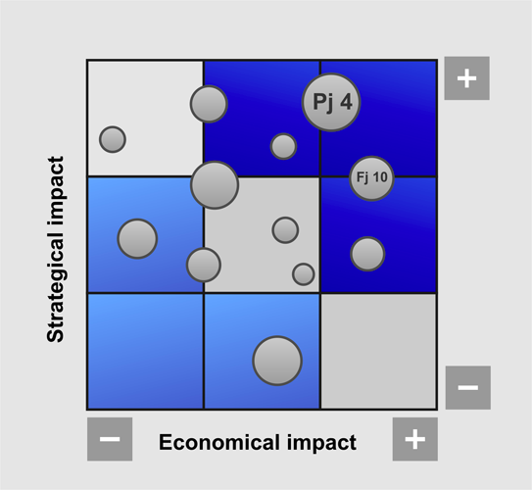
Course Learning Outcome: Progress
Explain program and portfolio concepts as they pertain to managing aggregates of software projects and assets.
Notes:
(28 min)

Slide 3
Context for Classic Program Management –
Corporate
Business
Drivers
Project
Progress,
Recommended
Actions
Operate
Business
Program/
Project
Progress
Manage
Program(s)
(Portfolio of Projects)
Delivered
Projects
(Successful)
Program
Needs,
CSFs
PM Policies
Plan Templates,
Mngt. Constraints
PMO/Project,
Trained PMs
PM Tools
Manage
Projects
Develop
PMs
Project
Requirements
PMO/Project,
Trained PMs,
PM Tools
Notes:
Show quickly… Explain IDEF0 or SADT nomenclature…

Slide 4


Why do we need Program Management?
Manage the range of projects in an organization
Manage the volume of projects in an organization
  Size/Scale
  Complexity
  (e.g., sophistication)
  Distributedness
  (e.g., Global teams)
Manage Value
  Risks
  Investments
Small
Project
Person
Project
Program
Large
Project
Notes:
What are three project perspectives addressed in program management? [Managing the range of projects, managing the volume of projects, managing the value of projects]

Slide 5

Group Exercise: Be Program Managers
Make this simple -- You have:
12 projects with varying
team configurations
12 different clients with varying
expectations and sophistication
Project deliverables all due at the same time
Team members will change
Clients may change
Quality must be maintained/rewarded
Team members must learn (be trained)
How would you organize for all of this?
Notes:
Hey, I’m a program director!!!

Slide 6
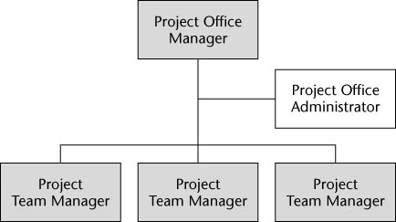
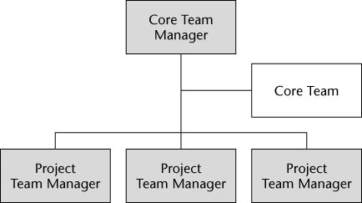
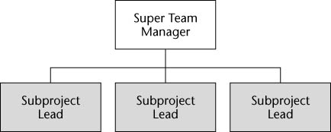
Classic: Program Management Organization
Project Office
  Layer of management to provide
  support and coordinate teams
  Temporary structure for big projects
Core Team
  Similar to the PO, but
  it has an advisory committee
  Subject matter experts
  work with teams as advisors
Super Team
  Integrate various teams
  into a huge super team
  Divide them into groups
  to focus on particular aspects
Notes:
Which of these three Program Management Organization team styles best supports the Junior Projects situation described earlier? Why? [Core team, it uses PM experts to advise the project teams]

Slide 7
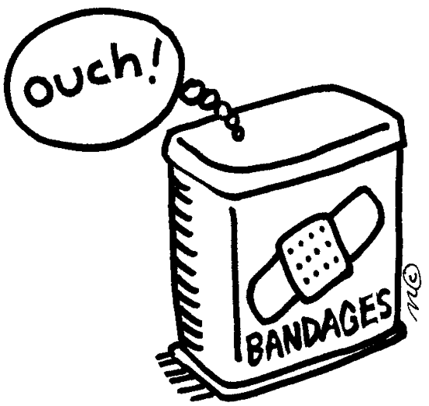
Program Management is needed if…
Project failure rates are too high
Training is not producing results
Project staff planning isn’t
effective
Inability to leverage best practices
Lack of control over the
project portfolio
Inconsistency in project reporting
Too many resource scheduling conflicts
Gap between process and practice
Notes:
Project Management is needed if there is a lack of ____________ over the project portfolio. [control]

Slide 8
PMO Capability Maturity Model (SEI)
Result
Value
Risk
Source: Bohner 1998
Notes:
What is the only Key Process Area for the Initial level of the Program Management Office Capability Maturity Model? [Acquiring new PMs]
Situation: You are a medium size software firm (~2000 employees)
You have four projects for the same customer and others that are similar
Customer is increasingly frustrated with the lack of coordination in reporting on these projects (different times, formats, rules/contracts, etc.)
Up to this point, you have managed projects locally on a project-by-project basis
How would you advance from ad-hoc project coordination to something more predictable and uniform?
Maturity, like with other endeavors, is a function of transition states where the understanding can only be truly appreciated from reaching a particular vantage point. For example, managing a team of 2 is good experience to prepare a PM for managing a team of 5, and so on. For PMO maturity, there are inflection points between the various levels that indicate when it is time or the value proposition is right to reach for the next level.
Less mature PMOs are simply a corral around the project managers so that basic reporting becomes consistent. At the other end of the spectrum are mature PMOs where traditional project issues (resource management, project prioritization, planning and tracking, project risk management, and the like) are coordinated to generate better economies of scale along with vendor, training, procurement, outsourcing, and risk management at the corporate level. Management moves from managing in-the-small projects to managing in-the-large initiatives and business portfolios.
While a few instances of capability maturity models for project management exist, none are complete or relevant enough to be accepted by the project management community at large. For practices, the Project Management Body of Knowledge (PMBOK) provides a reasonably well-accepted framework for project managers. IT executives must be able to characterize the capabilities and practices for project management performance from the corporate perspective.

Slide 9
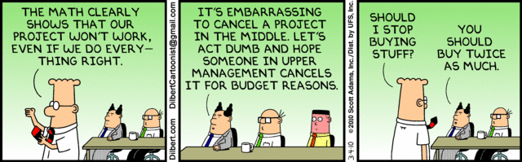
Dilbert on Managing the Project Portfolio

Slide 10
Perception of Software System Value
Efficiency Effectiveness
Business
Risk
Business
Value
High
Recognized Dependency
on Information or Service
Cost Investment
Business
Cost
Business
Opportunity
Low
Low
High
Perceived Capability of Software to Deliver Information or Service
Source: META Group
Notes:
When there is a high dependency on the information or service delivered by a low capability software system, how is the system managed? [as a business risk]

Slide 11
Software as Assets in a Portfolio Management Ecosystem
Enterprise Priorities
Project Proposals
Adjust
Project
Portfolio
Asset
Retirement
Project
Portfolio
Management
Asset
Portfolio
Management
Identify
Asset
Improvements
Assess
Value
Manage
Portfolio
Execution
Manage
Asset
Usage
Assess
Value
Implement
Projects/
Programs
New/Modified Assets
Operational Process
Program Management Process
Source: META Group
Notes:
Key Portfolio Management Roles:
Enterprise roles (Executives & Lines of business & Business function leaders):
Develop strategies for optimizing portfolio performance based on cost, efficiencies, alignment, risk, yield, and benefit
Analyze actual performance to develop more effective strategies
Justify fiscal responsibility to the business
Align business drivers and technology activities
Establish priority for resource allocation
Balance competing objectives to maintain portfolio’s value (business needs, economic priorities)
Ensure global/regional objectives are being addressed
Reinvest income generated by systems toward initiatives that enhance operational effectiveness and customer satisfaction
Chief Information Officer
Designates financial investments in AD/M projects
Determines baseline funding levels for each project and adjusts funding levels based on review schedule
Owns discussions around investment and venture project prioritization and funding
Owns operationalization of governance process, model, and priorities for entire organization
Ensures portfolio addresses global visibility
Initiates and drives work program process (demand, budget)
Facilitates communication of business requirements
Calls audit and analysis sessions
Develops new portfolios as need arises
End-to-end, cross-portfolio decommissioning strategy
Partners and synchronizes with CFO to ensure affordability matches spending levels
Validates and executes decision points for ventures
Relationship managers
Program & project managers
Infrastructure developers, operations managers, security professionals

Slide 12
Software Portfolio Analysis
Excellent
New
Development
Re-evaluate/
Reposition
Asset
Maintain/
Evolve Asset
Technical Condition
Is this like the MIT version of portfolios that you looked over?
Retire/
Consolidate
Asset
Reengineer /
Modernize
Asset
Poor
Low
Business Value
High
Notes:
When a software system has low technical condition and low business value, what course of action should be considered? [Retire the system or consolidate the system with other like systems]
Portfolio analysis:
Relative positioning of applications on a grid of technical condition and business value provides information for migration strategy and tradeoffs for investment decisions
Technical quality — architecture, adaptability, knowledgebase, stability, cost, dependencies
Functional quality — scope of use, shareability, criticality, completeness, correctness, limits to growth, ease of use

Slide 13
Software Portfolio Planning
Year 4…
Year 3
Excellent
Year 2
Re-evaluate/
Reposition
Asset
Maintain/
Evolve Asset
Technical Condition
Retire/
Consolidate
Asset
Reengineer /
Modernize
Asset
Poor
Low
High
Business Value
Notes:
Portfolio analysis:
Relative positioning of applications on a grid of technical condition and business value provides information for migration strategy and tradeoffs for investment decisions
Technical quality — architecture, adaptability, knowledgebase, stability, cost, dependencies
Functional quality — scope of use, shareability, criticality, completeness, correctness, limits to growth, ease of use

Slide 14
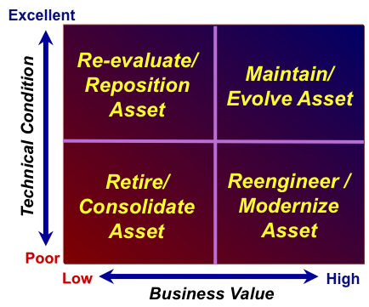
Group Exercise: Let’s play you bet your job!
You have 3 Software Assets
Old system with lots of
quality and maintainability
issues. Client is highly
dependent on this system
3 year old system with lots of
changes coming in from an
important customer.
New project to produce a key
system for an emerging customer-base
Place each of these on the quadrant chart.
How can you quantifiably justifying your choices?
Notes:
Which quadrant does software asset #1 go into? [Reengineer/Modernize asset]
Portfolio analysis:
Relative positioning of applications on a grid of technical condition and business value provides information for migration strategy and tradeoffs for investment decisions
Technical quality — architecture, adaptability, knowledgebase, stability, cost, dependencies
Functional quality — scope of use, shareability, criticality, completeness, correctness, limits to growth, ease of use

Slide 15
Project Prioritization Approaches
Non-Quantitative
  Forced Ranking
  Q-Sort
  Must Do – Should Do - Postpone
Quantitative
  Criteria Weighting
  Paired Comparison
  Risk/Benefit
Growth
OR
Survival
Notes:
What are three non-quantitative Project Prioritization approaches? [forced ranking, Q-sort, Must do—should do—postpone]

Slide 16
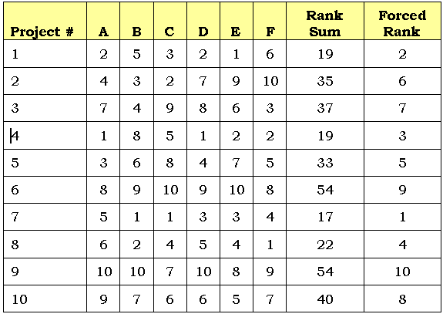
Forced Ranking
6 (A-F) Team members rank 10 projects

Slide 17
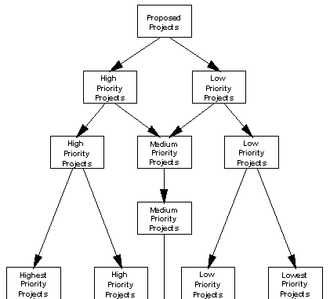
Q-Sort

Slide 18
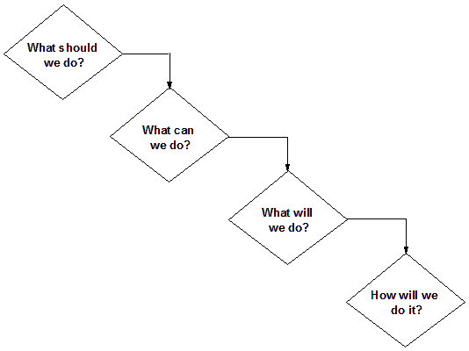


Pragmatic: Must Do - Should Do - Postpone
SELECT – Graham-Englund Model

Slide 19
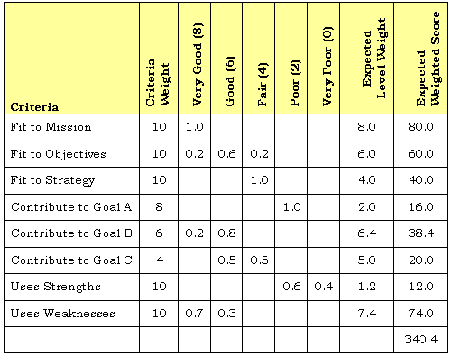
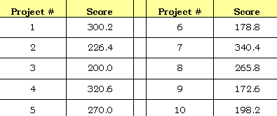
Scoring Model: Criteria Weighting
Project #7
Notes:
Multi-Attribute Utility (MAU)

Slide 20
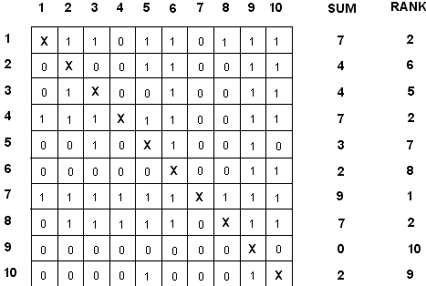
Scoring Model: Paired Comparisons

Slide 21
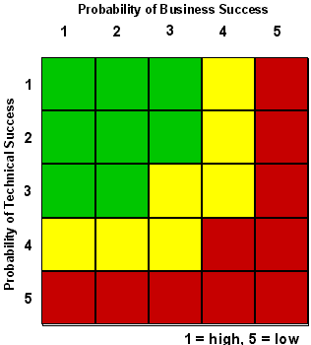
Scoring Model:
Risk/Benefit
Fund
Consider
Don’t fund
Notes:
Looks suspiciously like a risk matrix!

Slide 22
Some general lessons about this
Not all the “old school” ways of handling programs and portfolios are bad.
There may be some work to be done making things “lean” or “agile” at this higher level.
Meantime, our Agile projects need to play ball with the different ways these managers perceive things.
And, there may be differences we can’t get rid of – like the managers’ penchant for reducing everything to savings and profits!

